Slide 1


Classification of microbes
Lecture 2
Prof. Dr. Munira Ch. Ismaeel
Ass. Prof. Dr. Israa AJ Ibrahim

Slide 2

Classification of microbes
Prof. Dr. Munira Ch. Ismaeel and Ass. Prof. Dr. Israa AJ Ibrahim

Slide 3
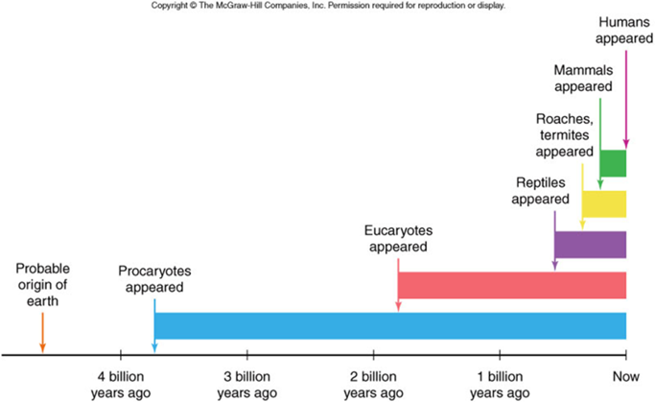
The progenitor Lec.2

Slide 4
The progenitor
3.4 billion years ago -- First photosynthetic bacteria
they absorbed near-infrared rather than visible light and produced sulfur or sulfate compounds rather than oxygen. Their pigments (possibly bacteriochloro¬phylls) were predecessors السلف to chlorophyll.
2.4–2.3 billion years ago -- First rock evidence of atmospheric oxygen
2.7 billion years ago -- Cyanobacteria
these ubiquitous bacteria were the first oxygen producers. They absorb visible light using a mix of pigments: phyco¬bilins, carotenoids and several forms of chlorophyll.
1.2 billion years ago -- Red and brown algae
these organisms have more complex cellular structures than bacteria do. Like cyanobacteria, they contain phycobilin pigments as well as various forms of chlorophyll.
0.75 billion years ago -- Green algae
Green algae do better than red and brown algae in the strong light of shallow water. They make do without phyco¬bilins.
0.475 billion years ago -- First land plants
Mosses and liverworts descended from green algae. Lacking vascular structure (stems and roots) to pull water from the soil, they are unable to grow tall.
0.423 billion years ago -- Vascular plants
These are literally garden-variety plants, such as ferns, grasses, trees and cacti. They are able to grow tall canopies to capture more light.

Slide 5
Microbial Taxonomy
Classification, Taxonomy, Binomial Nomenclature
The Classification of Living Things: Living organisms are assigned to groups based upon their similarities.

Slide 6
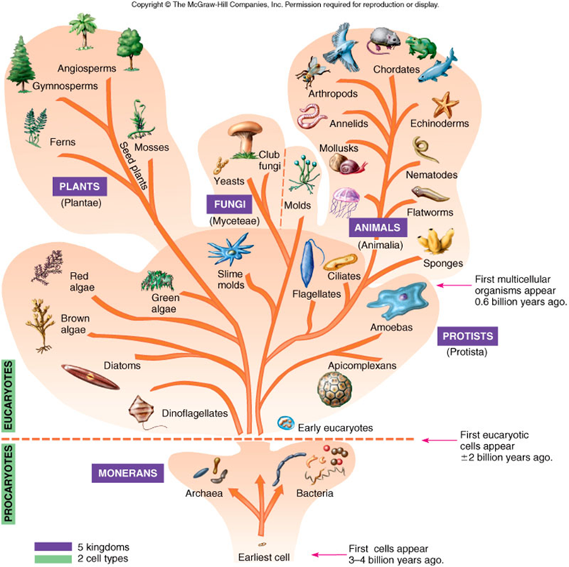
Traditional Whittaker 5 Kingdom System (1957)

Slide 7
Traditional Whittaker 5 Kingdom System (1957)
There are 5 old kingdom scheme is still widely used:
Monera – bacteria (Prokaryotic)
Protista – Protozoans (Eukaryotic)
Fungi - yeast, molds, etc. (Eukaryotic)
Plant – photosynthetic producers (Eukaryotic)
Animals – heterotrophic consumers (Eukaryotic)

Slide 8
Categories of Classification
Domain
Kingdom
Phylum
Class
Order
Family
Genus
Species

Slide 9
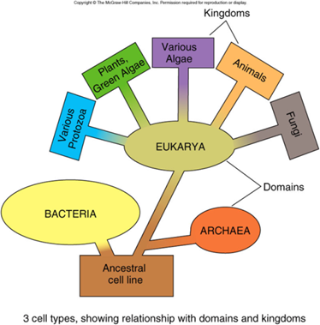
Woese-Fox 3 Domain System (1977):
-The highest – largest category, recent addition
3 domains:
1. Archaea – ancient “bacteria”, unicellular like bacteria, also simple cell structure (prokaryote – no nucleus) but have distinct metabolism (chemistry) allowing them to exist in “extreme” environments.
2. Bacteria – unicellular, prokaryote, found everywhere (Old kingdom name – Monera)
3. Eukarya – unicellular to multicellular, complex and organized cells with nuclei and organelles (mitochondria).

Slide 10
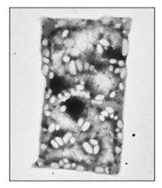
Archaea
Prokaryotes
Lack peptidoglycan
Live in extreme environments (extremophiles)
Include:
- Methanogens
- Extreme halophiles
- Extreme thermophiles

Slide 11
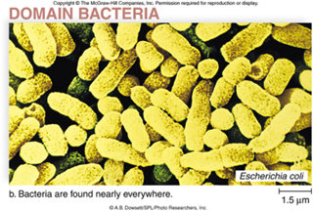
Bacteria
Prokaryotes
Peptidoglycan cell walls
Binary fission
Ex: Escherichia coli

Slide 12
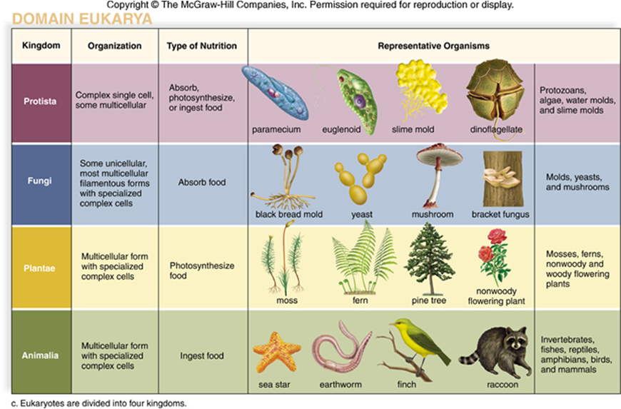
Domain Eukarya

Slide 13
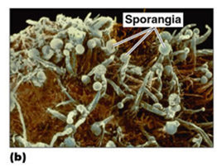
Fungi
Eukaryotes
Chitin (Chitin is a modified polysaccharide that contains nitrogen) cell walls
Molds and mushrooms are multicellular
Yeasts are unicellular

Slide 14
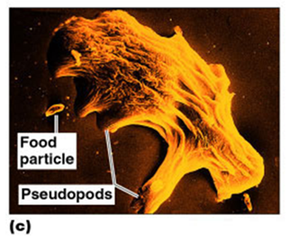
Protozoa
Eukaryotes
Mostly saprobes and commensals
May be motile by means of pseudopod, - cilia or flagella

Slide 15
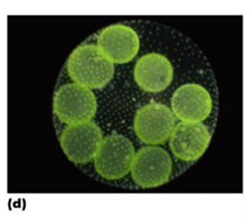
Algae
Eukaryotes
Cellulose cell walls
Photosynthetic
Produce molecular oxygen and organic compounds
Part of food chain

Slide 16
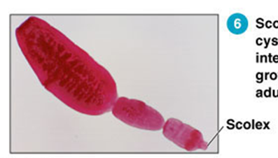
Helminthes
Eukaryotes
Multicellular animals
Parasitic flatworms and roundworms - called helminthes
Microscopic stages in life cycles

Slide 17
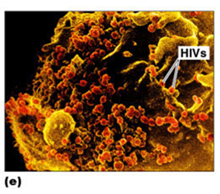
Viruses
A cellular
Obligate intracellular parasites
Genome consist of DNA or RNA called Core
Core surrounded by protein coat called Capsid
Virion may be enclosed in lipid envelope

Slide 18
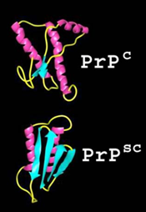
Prions
Proteinaceous infectious agents
Causes Bovine Spongiform Encephalopathy (BSE)

